Slide 1
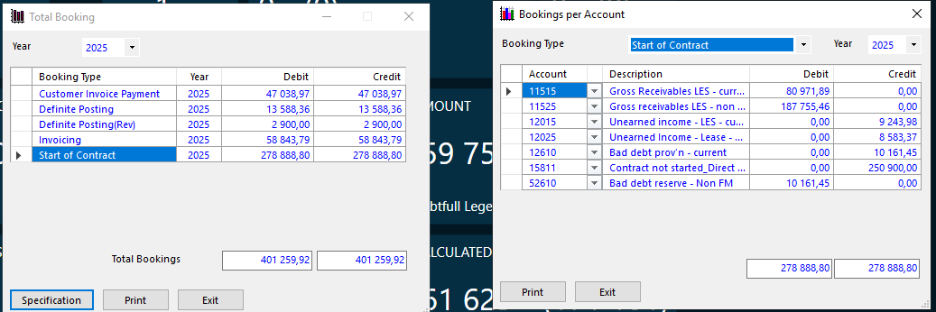
Total reconciliation
The routine shows a specification of how the sum in base currency is divided at account level.
The sum in base currency is displayed per:
◾Financial Year
◾Booking Type
It is possible to switch between different booking types and financial years.
It would be great to include the column external account parts in the grid that shows Bookings per account.
In this form the user can, at Accounting event level, view the amounts that has been booked in base currency. The amounts can be viewed per financial year and include all contracts in the database.
A more thorough analysis is possible for each booking type where a specification of the amount in base currency, divided at account level, is presented. This can be performed by clicking the Specification button.

Slide 2
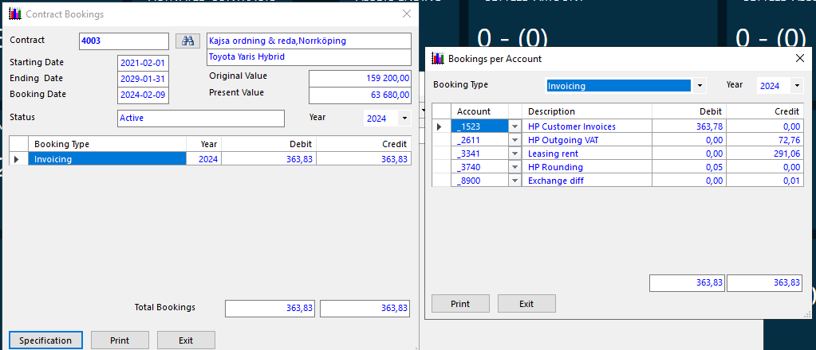
Agreement reconciliation
In this form the user can, at contract level, view the amount that has been booked in Debit and Credit for each Accounting event
The information can be viewed per financial year.
In order to perform a deeper analysis, for each accounting event it is possible to see how the amounts in base currency are divided at account level. Click on the button Specification or double-click on the line in the grid to view the transaction at account level.
Shows a specification on how the sum in base currency is divided at account level. The sum in base currency is viewed per:
◾Contract
◾Financial Year
◾Accounting event
In the routine it is possible to change between different Accounting events and financial years.

Slide 3
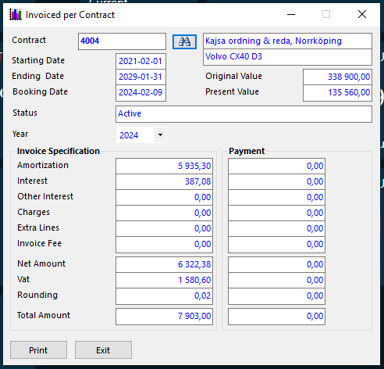
Invoice reconciliation
The form shows, at contract level, the amount that a contract has been invoiced respectively the amount the customer has paid since the start of the contract. The amounts are given in contract currency.
The information is divided into: (The different amount types that has been used for the invoice)
  Amortization
  Interest
  Overdue Interest
  Added cost
  Invoicing Fees
  Net Amount
  VAT
  Rounding
  Total Amount
Selection of the information is possible per financial year
.

Slide 4
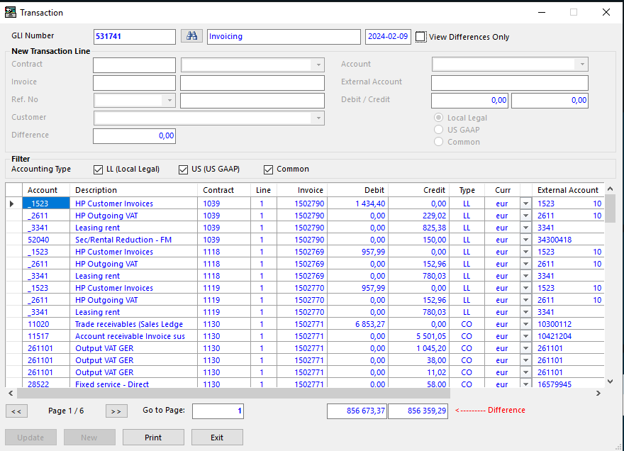
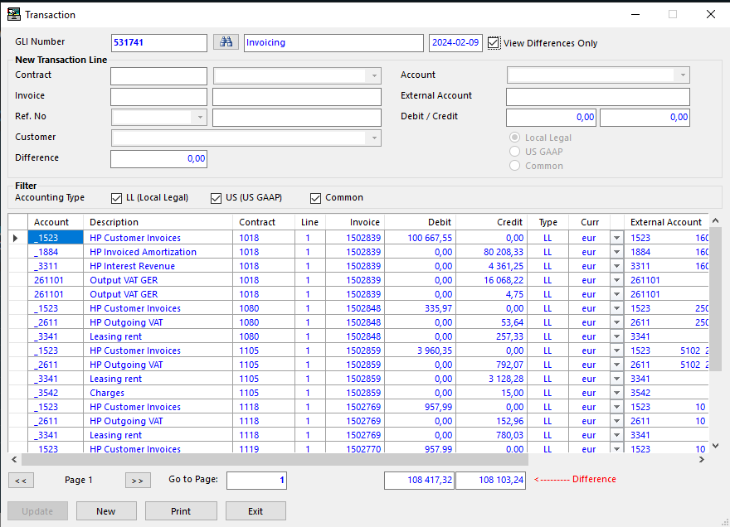
View Differences Only
If the check box is checked, then the grid only displays transaction
lines where differences in base currency exist.

Slide 5
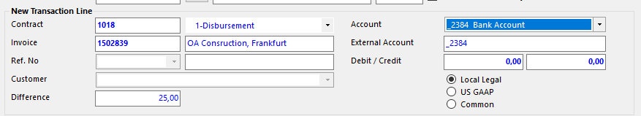
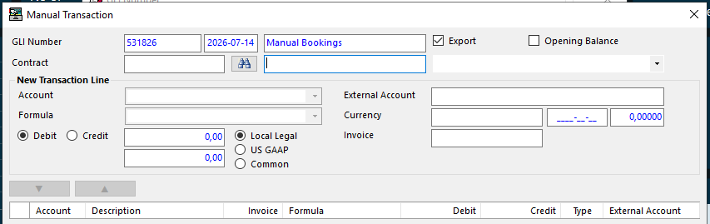
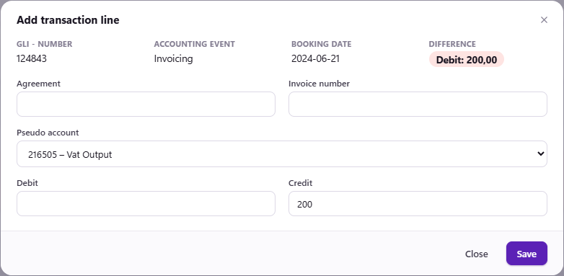
We need the following fields to be added in form ‘Add transaction Line’ :
Agreement Line
external account (part)
Currency
Customer
Invoice
Supplier
Reference number
Ledger

Slide 6
Close Period
This routine is used to close a period in Accounting domain for a legal entity, thus not allowing any booking dates in closed periods when creating the export transactions to the general ledger.
Is used in order to, when exporting Journals/GLI-numbers, ensure that the exported booking date for any historical booking dates, are set to the first day of the first "open" period for such items.
A Journal/GLI -transaction cannot be exported with a booking date before the first day of the current period in Accounting domain for corresponding legal entity.
Example:
A retroactive start of an agreement takes place – the starting date of the agreement is a date that is in a period that has been closed.
Accounting event ‘Activation’ has calculation date as booking date.
Accounting event ‘Activation’ has a number of Accounting Rules that causes a transaction in Accounting domain.
The booking date in Accounting will be that actual date (i.e. in the closed period). At the export to the general ledger,
the exported booking date will be changed to the first day of current period.

Slide 7
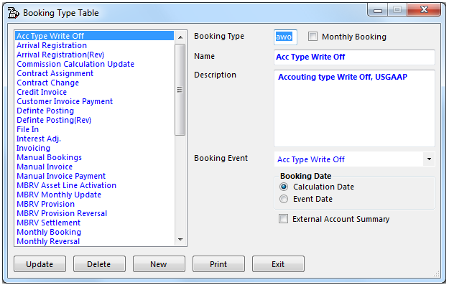
Calculation Date - Booking Date
Controls the date used as booking date when booking transactions
are generated by the Accounting event.
If Calculation Date is selected for a Accounting event, then Accounting creates
a booking transaction with booking date = a specific date from the
Agreement / Agreement line.
For example, Accounting event “Activation", shall use the same date
as the start date of the Agreement line as Booking Date. If the agreement
line is started today with a start date in the future, then the Booking
Date of this transaction will be created with a date in the future, i.e.
the same as the start date of the agreement line.
If the used start date is older than current date, then Booking Date
of the transaction will be created with the current date, if Calculation
Date is used and the start date lies in a period that is closed for booking
in accounting.
Event Date - Booking Date
Controls the date used as booking date when booking transactions
are generated by the accounting event.
If Event Date is selected for a accounting event, then accounting creates a
booking transaction with booking date = the actual day when the Event
occurred.
For example, accounting event"Invoicing" shall use the date when the
invoicing was run as booking date.
This is a setting we have on the accounting events

Slide 8
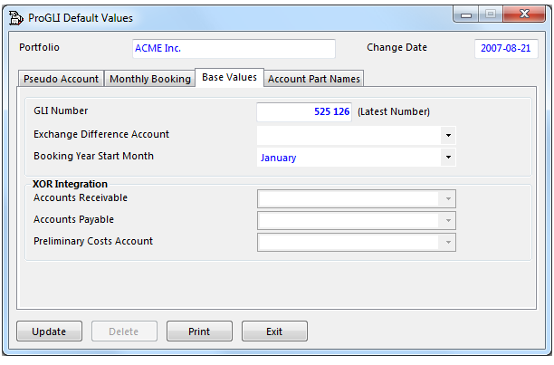
Exchange Difference Account
This combo box defines the pseudo account that shall be used to
book exchange rate differences that can occur when the base currency
differs from contract currency.
At some occasions, base currency differences in a GLI transaction may
occur even if the transaction balance in contract currency and the same
exchange rate has been used at the recalculation.
These differences occur because ProGLI rounds the amount in base
currency to two decimals.
In order to book these small differences, an Exchange Difference
Account must be defined.

Slide 9
We have gli-number Serie and that should say this is the latest used Journal/gli number used on each legal entity so that one has to be updated when a new Journal/GLI is created on that legal entity , I do not think that is the case right now

Slide 10
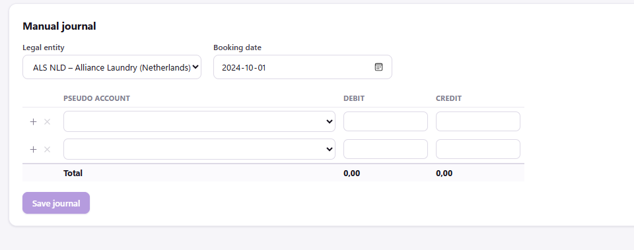
We need the following fields to be added in form ‘Manual Journal’ :
Agreement
Agreement Line
external account (part)
Currency
Customer
Invoice
Supplier
Reference number
Ledger

Slide 11
In form pseudo account we have a grid with all pseudo accounts and a column that says ‘chart of account’ and clicking on that one takes you to the chart of account but not positioned on that pseudo accounts place in the chart of account it is always no matter of which pseudo account positioned on top of the chart of account

